Slide 1
Retail Sales Analysis
Business Problem
Effective sales management are critical for optimizing profitability in the retail industry. Companies need to ensure that they are not incurring losses due to sales trends, poor products performance, or low impact of discounts, Through detailed Exploratory Data Analysis and Time Series trend evaluation. The goal of this analysis is to:
Identify Sales Trends and Seasonality Across Products and Regions.
Determine the Best and Worst Performing Products Based on Sales Volume and Revenue.
Measure the Impact of Discounts and Promotions on Sales Performance.
Identify Regions with the Highest Growth Potential.
Analyze Sales Performance Across Different Customer Segments.
Identify underperforming brands that require promotional or pricing adjustments.

Slide 2
Assumptions Research Question 1. What are the monthly/seasonal patterns in sales to optimize inventory and marketing? 2. What is the products rank to focus on top-sellers and discontinue low performers? 3. Which regions demonstrate the highest potential sales growth for future purposes? 4. Understand which customer groups contribute most to sales? 5. What are the low performance brands that require promotional or pricing adjustments? Hypothesis 1. Season/month-wise sales data can reveal recurring trends with greater accuracy. For example, ice cream sales typically peak between May and August, while winter jacket sales tend to rise between November and January. 2. Top-selling products exhibit higher unit sales, satisfactory customer ratings, and generate greater revenue. 3. Brands with lower unit sales and reduced revenue require strategic promotional adjustments.

Slide 3
Exploratory Data Analysis (EDA) Correlation between price and Per product sales Price Sales So, we observe from above analysis that price increase then sales decrease or vise-versa. Month wise Sales From the analysis, it is observed that the months of March and August records slightly higher sales compared to other months. However, sales in all months remained consistently above ₹3 crore.
1. | -0.0436085
-0.0436085 | 1.

Slide 4
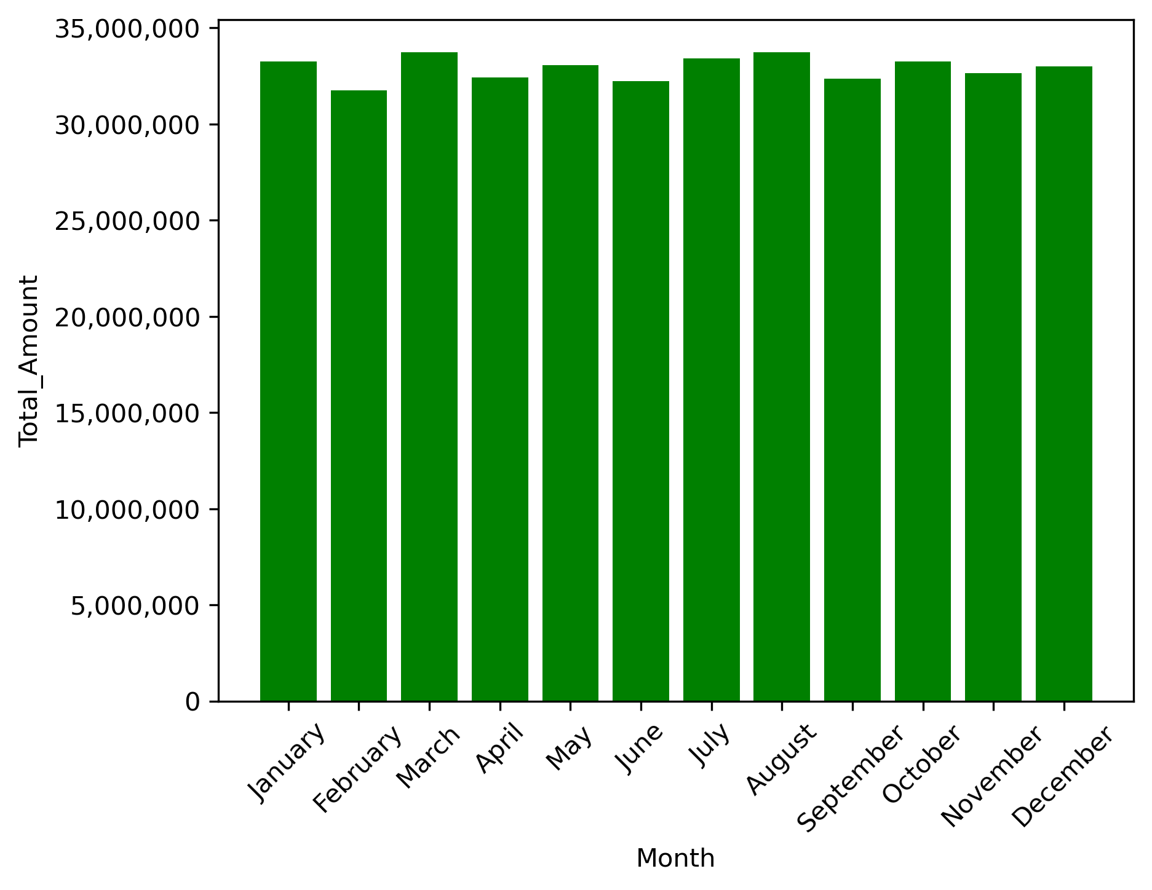

Slide 5
Month wise product sales Overall, product sales remain consistent across months and seasons. Among all items, Water records the highest sales volume at approximately 11,000 units, contributing to nearly 70% of total sales. Following this, Smartphone, Non-Fiction, and Fiction products each achieve around 8,000 units in sales. In the mid-range category, products such as Television, Decorations, Tablet, Furniture, T-shirt, Shoes, and several others register sales of approximately 5,350 units and all are in between 32% to 34%. At the lower end, items including Headphones, Laptop, Shirt, Coffee, Literature, Shorts, Bathroom, Jacket, Children’s, Kitchen, Chocolate, Dress, Bedding, and Tools each record sales close to 2,800 units and all are below 19% of the total sales. The BlueStar AC ranks lowest overall, with just 1,000 units sold. The desired month-wise sales pattern could not be distinctly identified from the available data.

Slide 6
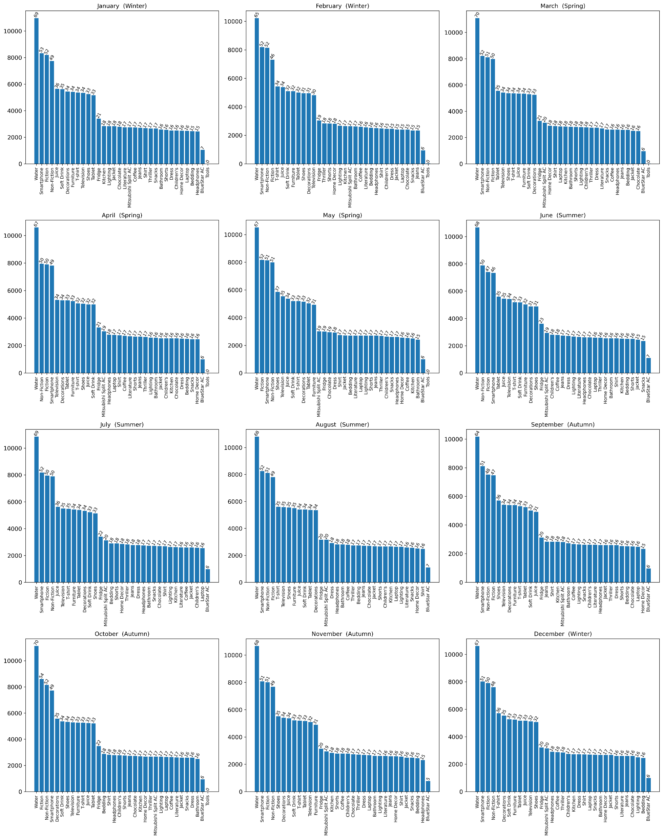

Slide 7
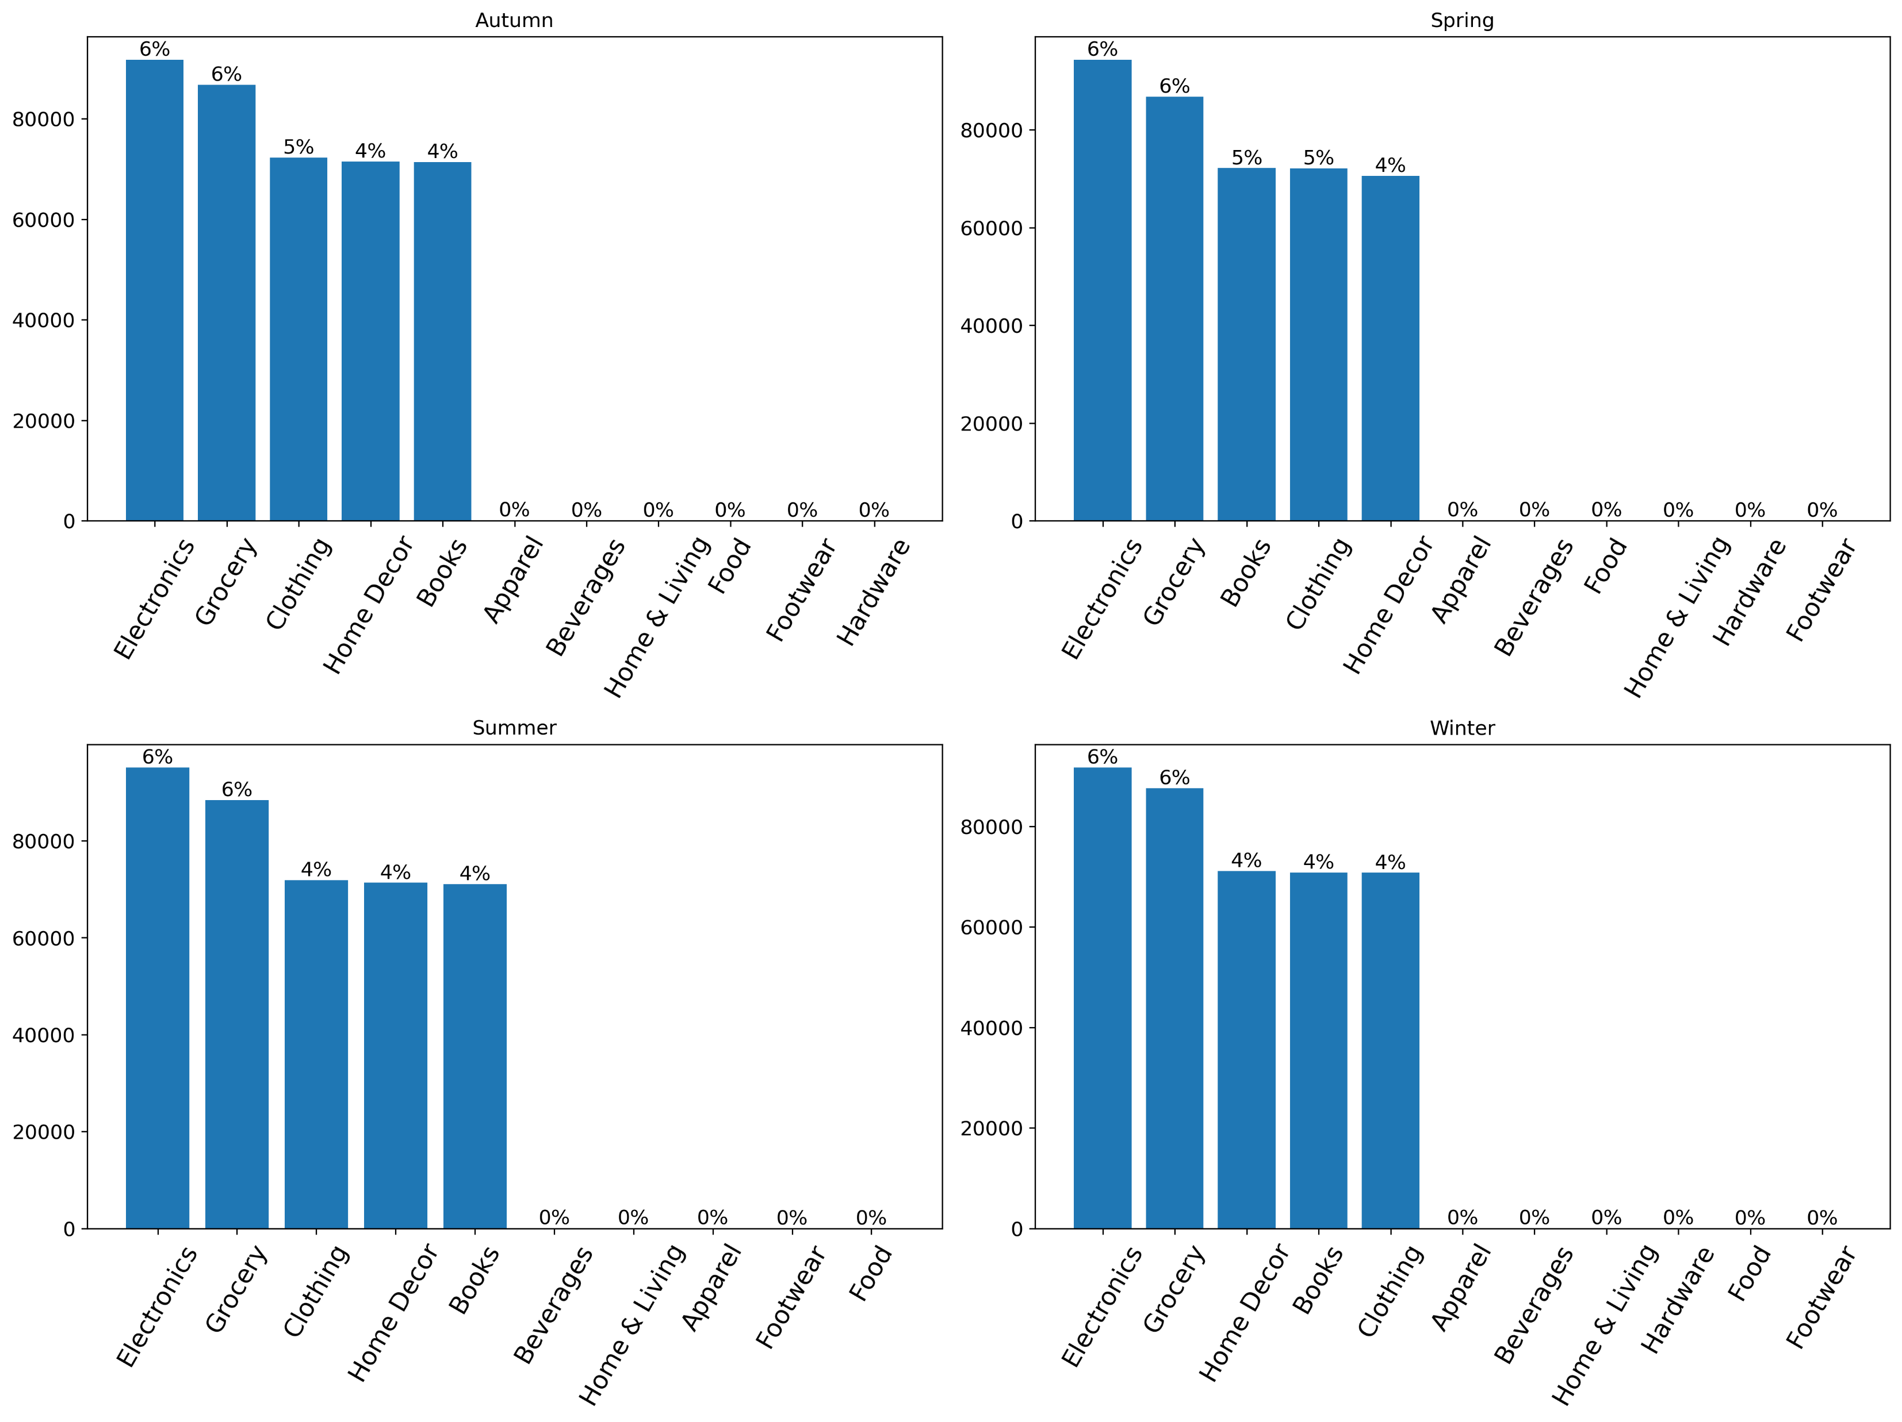
Season Wise Product Sales Our initial assumption was incorrect, as the desired season-wise sales pattern could not be distinctly identified from the available data. Analysis reveals that Electronics recorded approximately 95,000 sales, while Grocery accounted for around 87,000. Clothing, Home Decor, and Books each achieved roughly 73,000 sales, with all these categories maintaining similar sales figures across all four seasons. Apparel, Footwear, Food, Home & Living, Beverages, and Hardware sales are below 100.

Slide 8
Top Sellers based on products rank The analysis reveals that Water leads sales with 130,000 units and is also the highest revenue generator at ₹32,112,619. Smartphones, Fiction, and Non-Fiction follow with sales between 92,000 and 97,000 units. Mid-range products such as T-Shirts, Shoes, Televisions, Tablets, and Furniture record steady sales between 60,000 and 65,000 units. Lower sales categories include Fridges, Coffee, Headphones, and Jeans with 30,000 to 40,000 units. The lowest-performing items are Snacks, BlueStar AC, and Tools, and these should be considered for discontinuation to optimize store space and reduce costs.

Slide 9
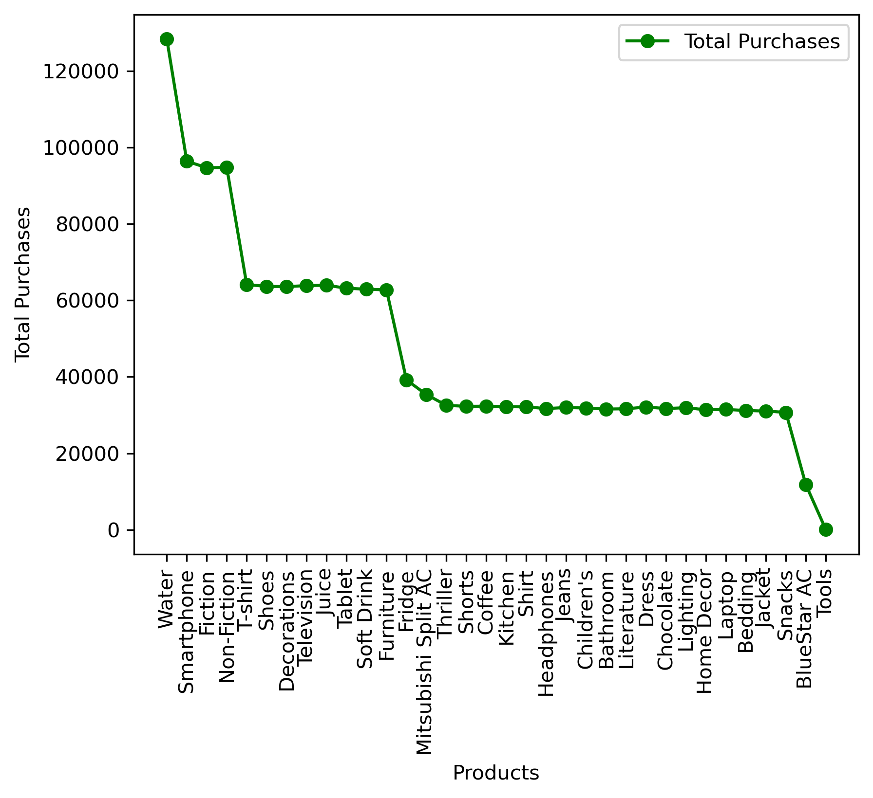
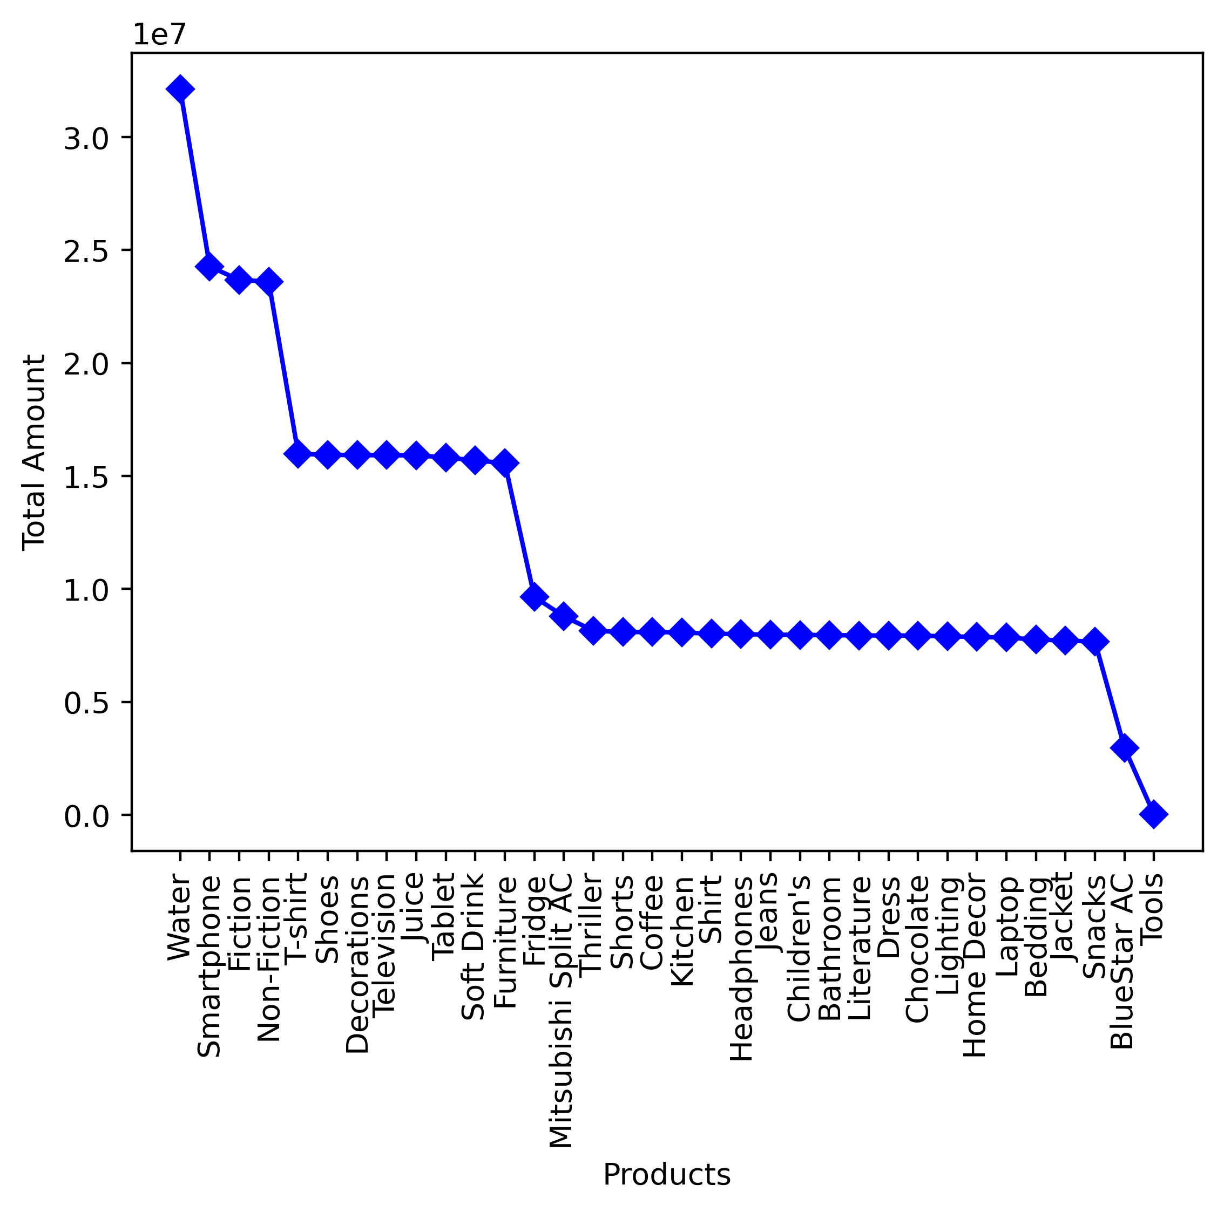

Slide 10
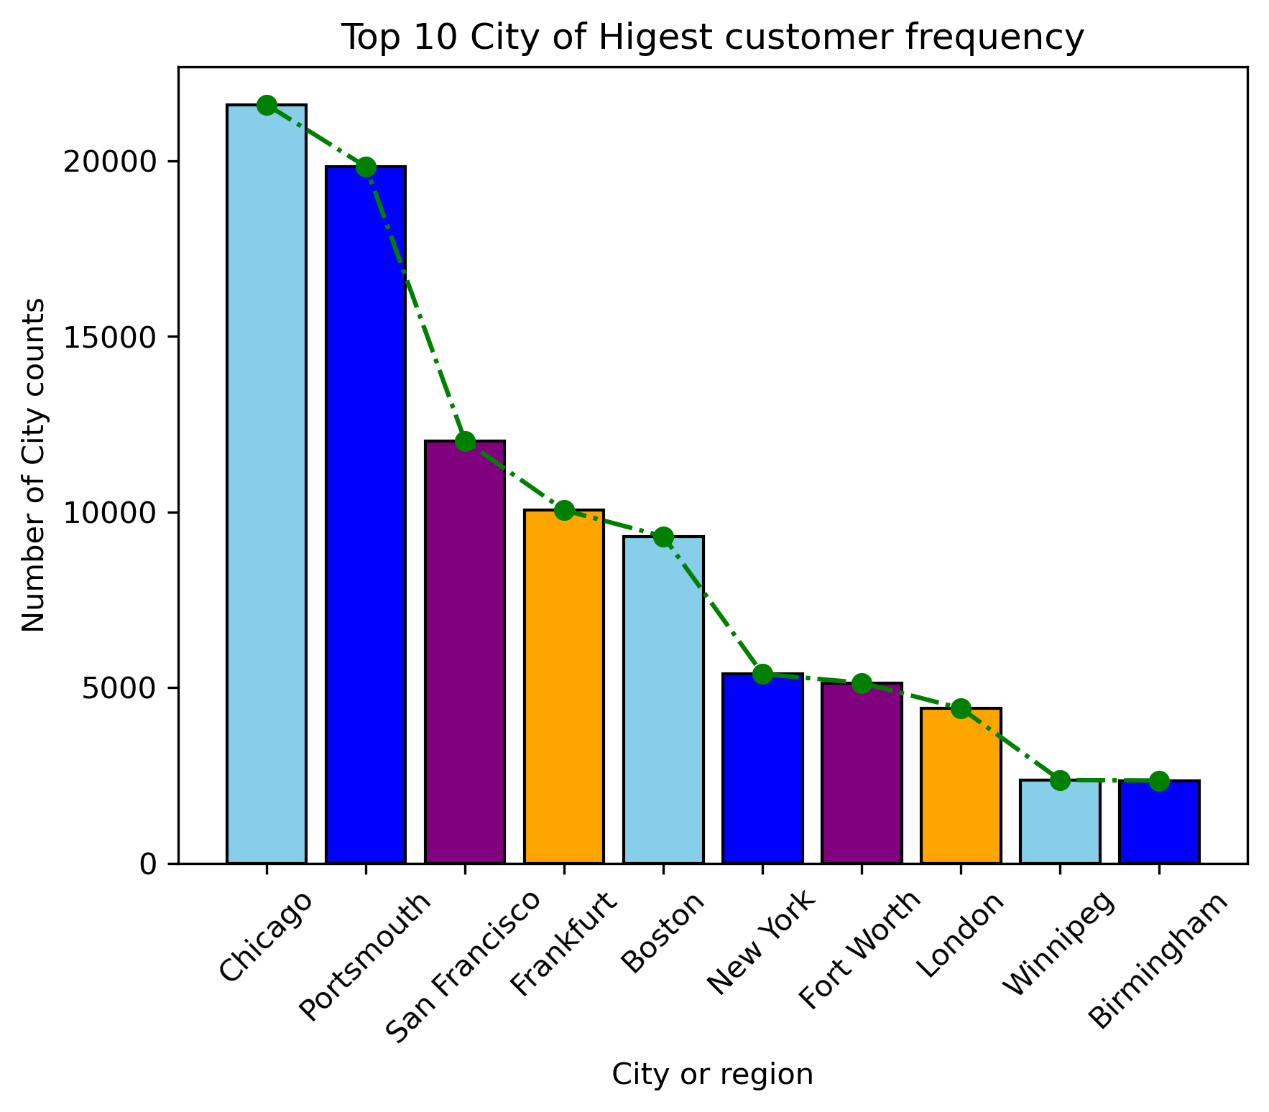
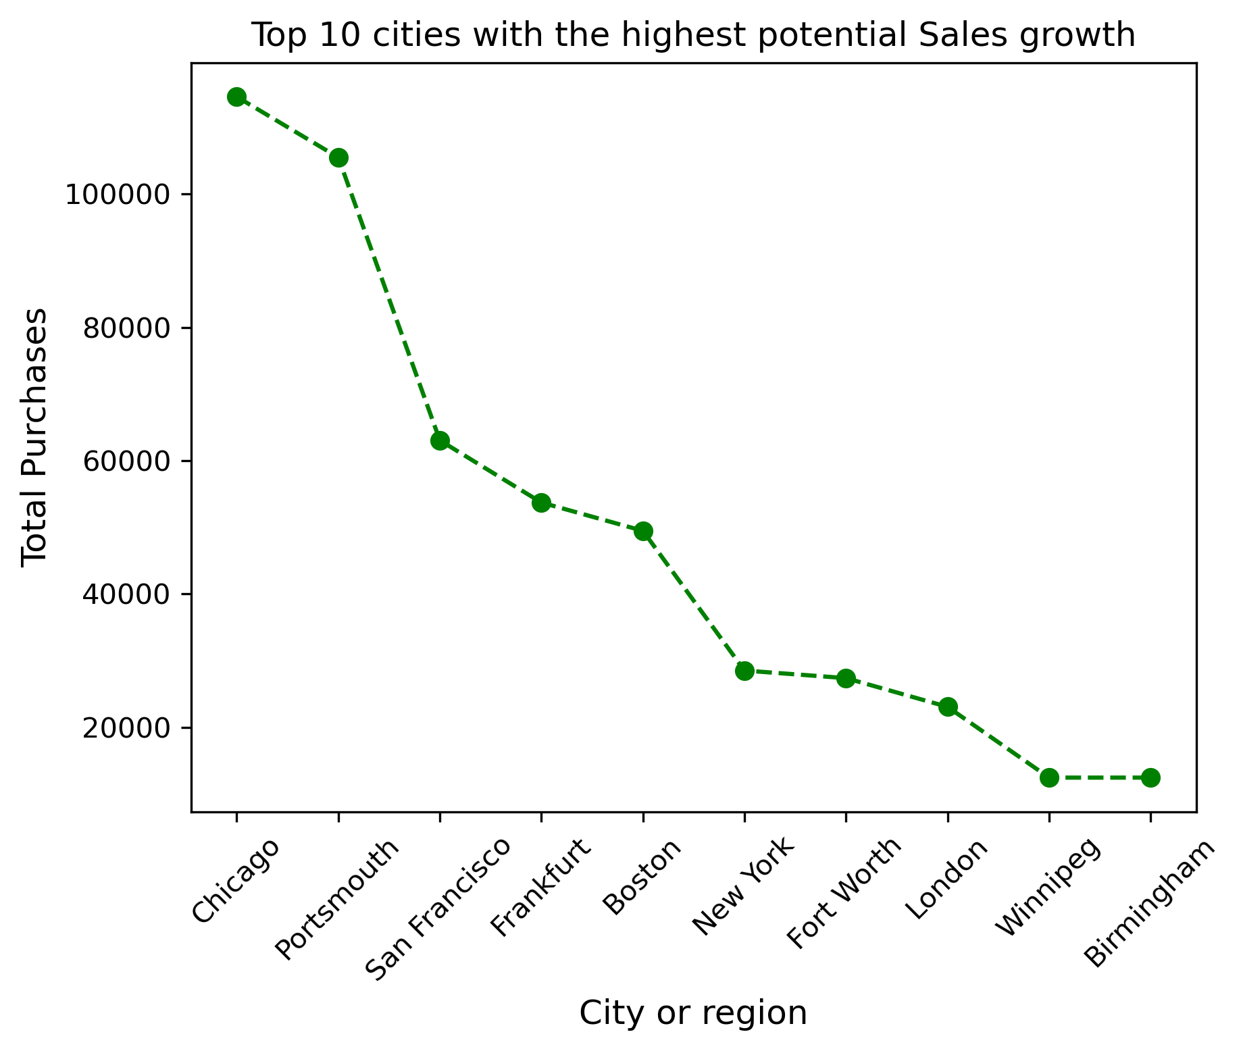
Region wise Sales growth

Slide 11
The analysis of city-level data highlights the Top 10 cities with the highest customer frequency, namely Chicago, Portsmouth, San Francisco, Frankfurt, Boston, New York, Fort Worth, London, Winnipeg, and Birmingham. These regions demonstrate the strongest customer presence and significantly contribute to overall sales growth. Among them, Chicago emerges as the leading sales region, recording the highest total purchase value of approximately 114,599. Portsmouth, San Francisco, and Frankfurt follow as the second tier of high-performing cities, with total sales ranging from 1.6 lakh to 54,000. Cities such as Boston, New York, London, Winnipeg, and Birmingham show comparatively moderate sales, ranging between 50,000 and 12,000. From this analysis, it is evident that Chicago, Portsmouth, San Francisco, and Frankfurt are the most critical sales hubs, as the majority of customers and sales revenue are concentrated in these four regions. These findings suggest that strategic focus on these areas could further enhance sales performance and strengthen market presence.

Slide 12
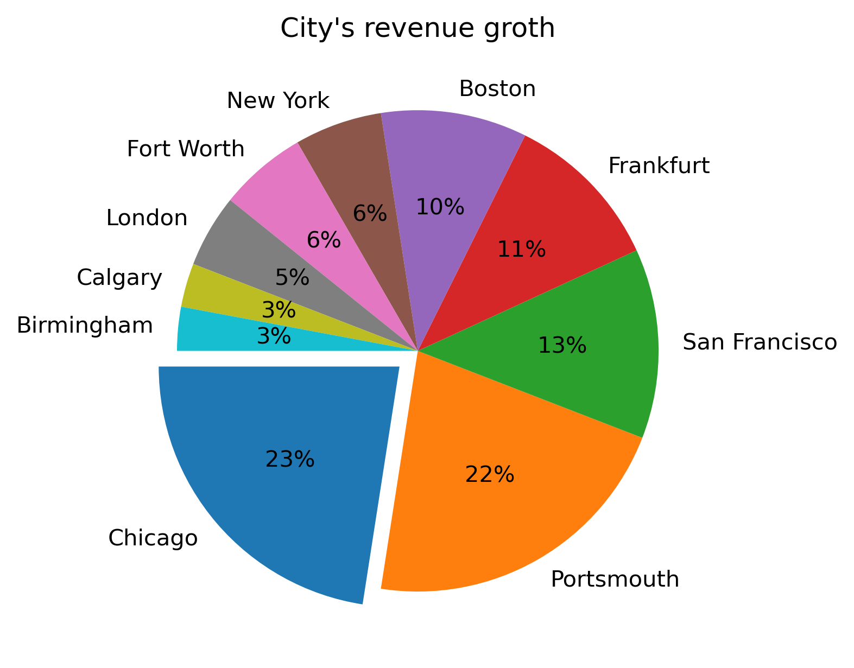
Region wise revenue growth According to the city-wise sales growth analysis, revenue growth closely aligns with sales performance. Chicago leads with revenue of ₹28,38,4,601.00, contributing approximately 23% of the total. Portsmouth follows with ₹26,31,9,836.00 (22%), while San Francisco records ₹15,75,5,877.00 (13%) and Frankfurt contributes ₹13,35,0,896.00 (11%). From this analysis, it is evident that Chicago, Portsmouth, San Francisco, and Frankfurt represent the highest potential sales and revenue growth regions, whereas the remaining cities demonstrate comparatively lower growth.

Slide 13
High contributing customer group on sales An age-wise sales analysis was conducted to identify the customer segments contributing most significantly to overall revenue. The results reveal that the 20–30 age group is the highest contributor, generating approximately ₹6.5 lakhs in sales. This is followed by the 40–50 age group, which contributes around ₹2.9 lakhs, while the 30–40 age group records a comparatively lower contribution of about ₹2.3 lakhs. At the other end of the spectrum, the 70–80 and 10–20 age groups represent the lowest contributing segments, with sales of nearly ₹89,733 and ₹14,343, respectively. From the graph, it is evident that customers in the 20–30, 40–50, and 30–40 age brackets are the most influential segments driving overall sales performance.

Slide 14
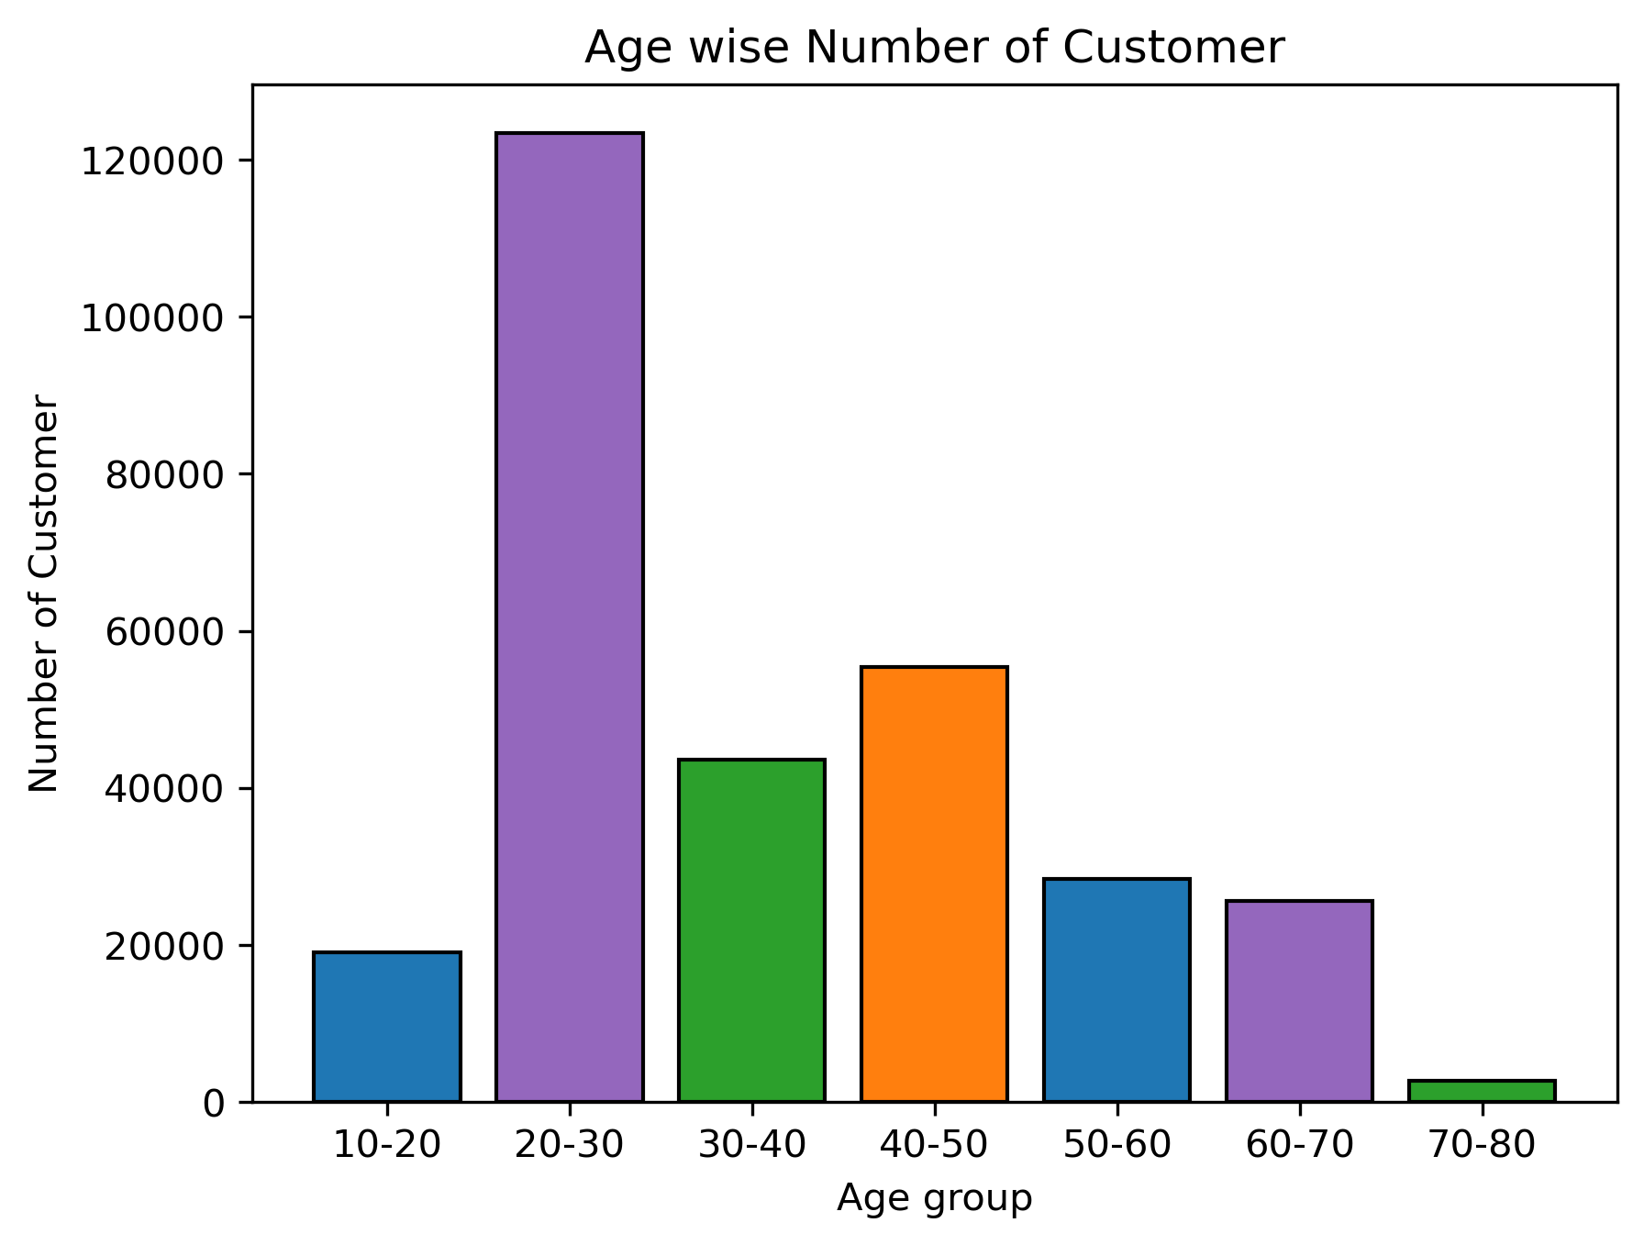
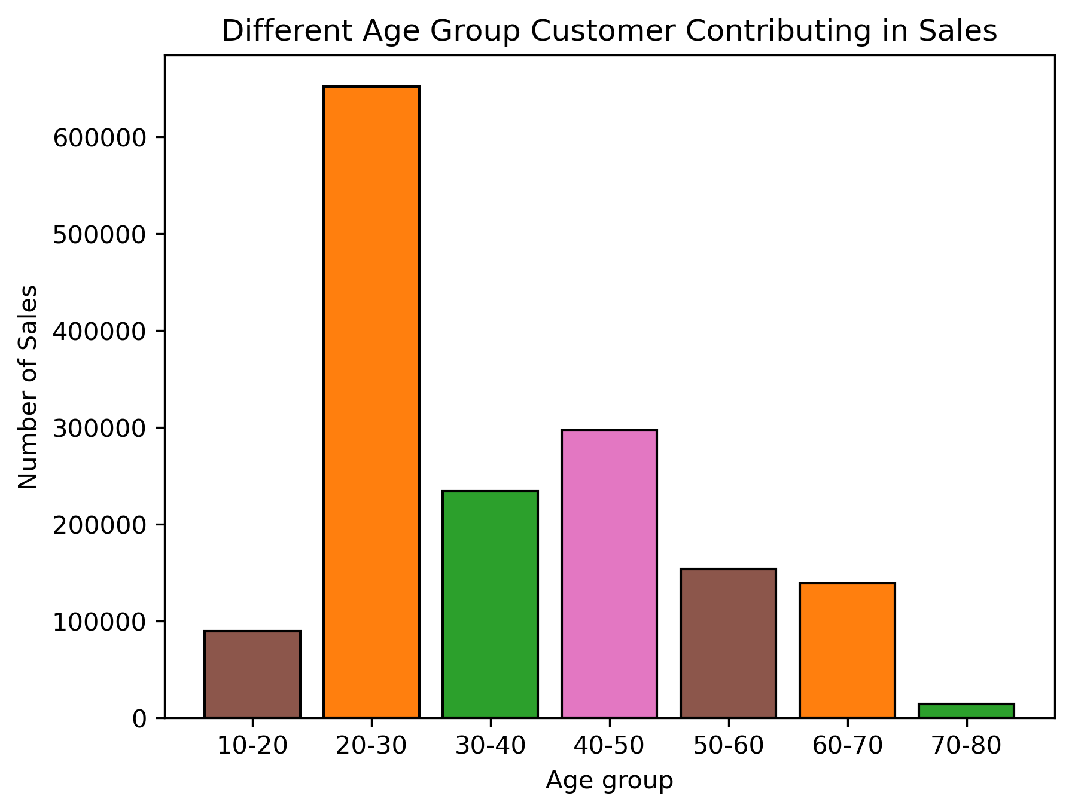

Slide 15
Brands that require promotion and pricing adjustments The analysis of brand-wise sales frequency indicates that leading contributors include Pepsi, Coca-Cola, HarperCollins, Zara, Samsung, Sony, and Adidas, with sales ranging from approximately 158,651 to 94,000 units. In contrast, brands such as Whirlpool, Mitsubishi, and BlueStar demonstrate significantly lower sales performance, with frequencies between 39,000 and 11,000 units. These lower-performing brands present an opportunity for targeted promotional strategies and pricing adjustments to enhance their market contribution.

Slide 16
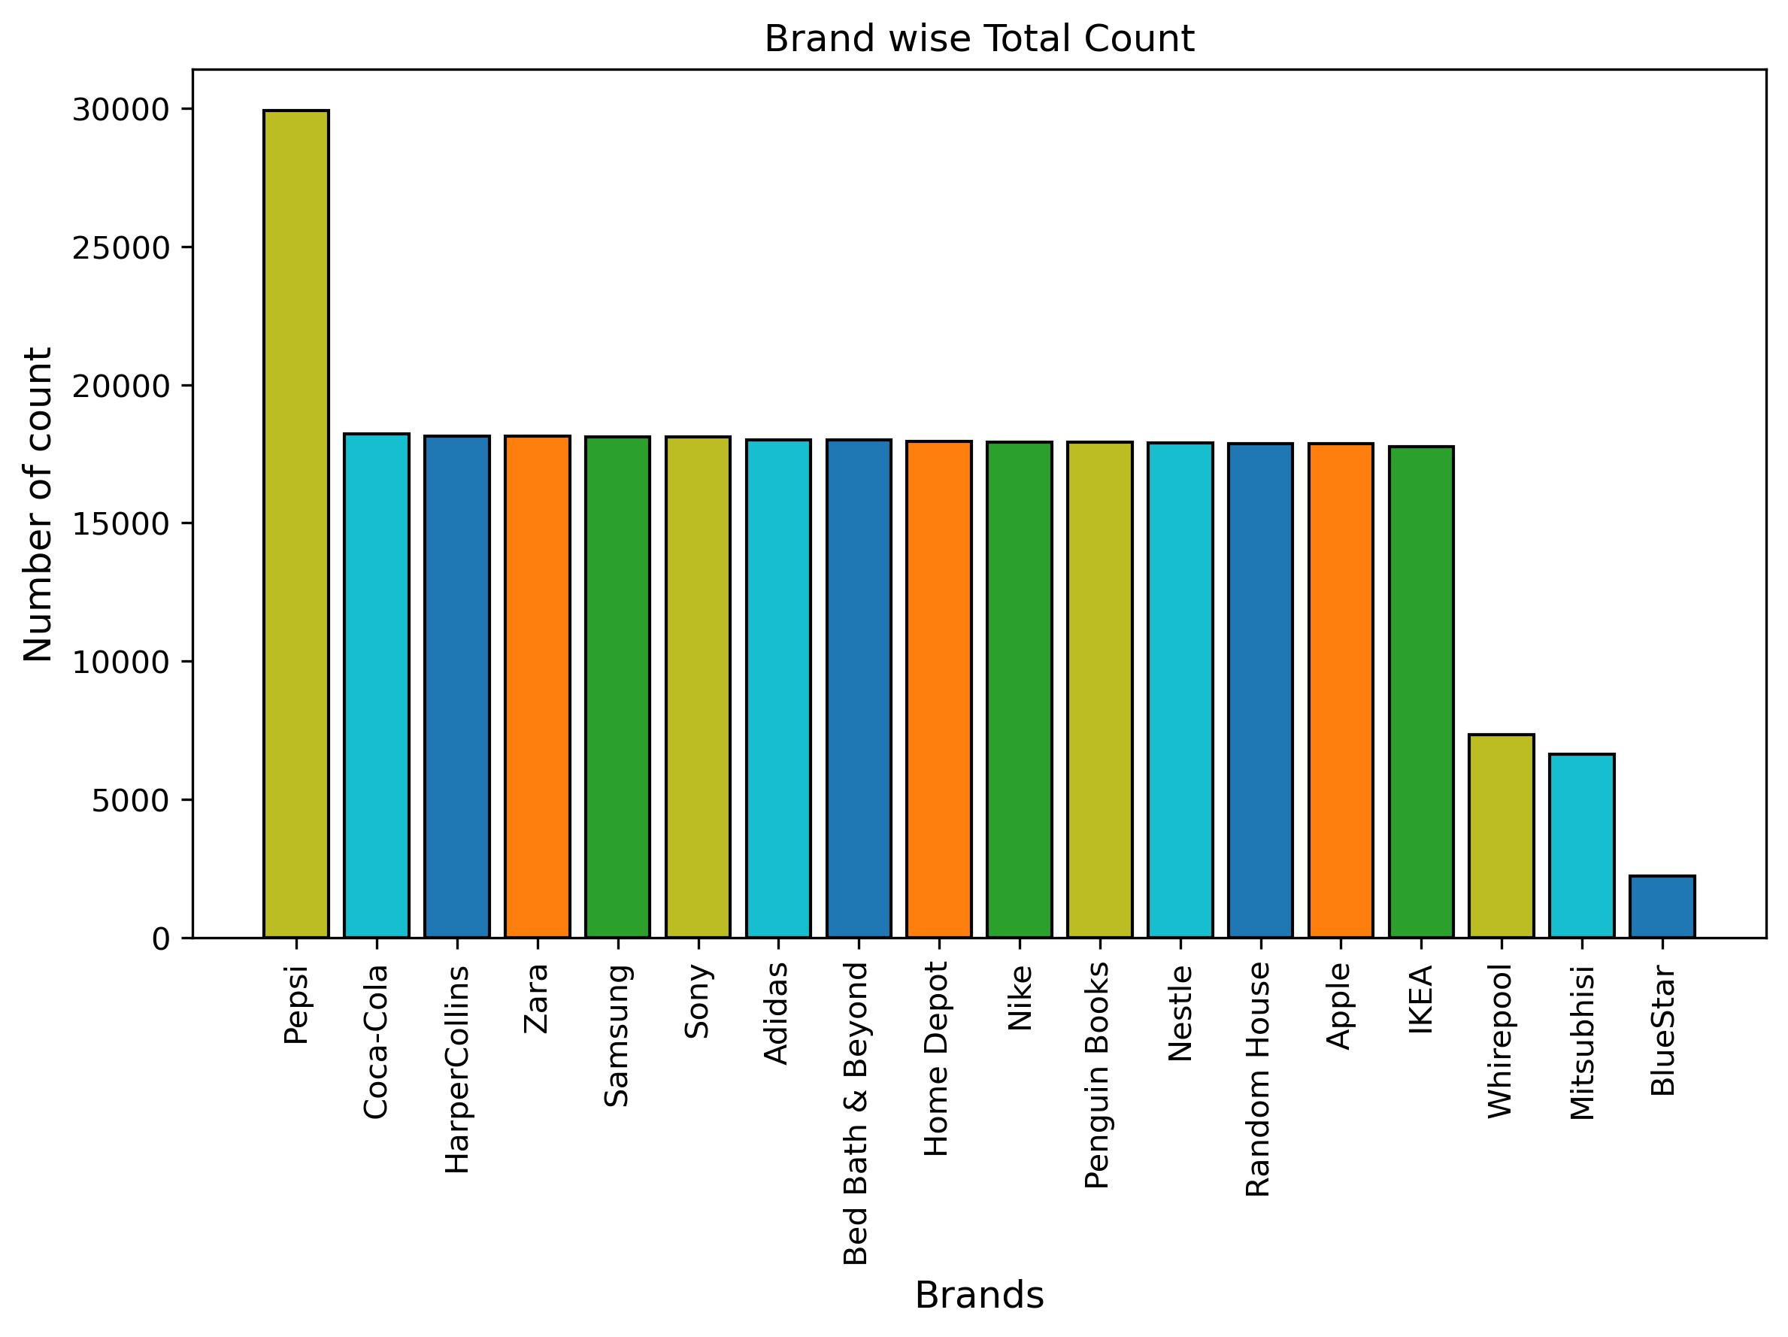
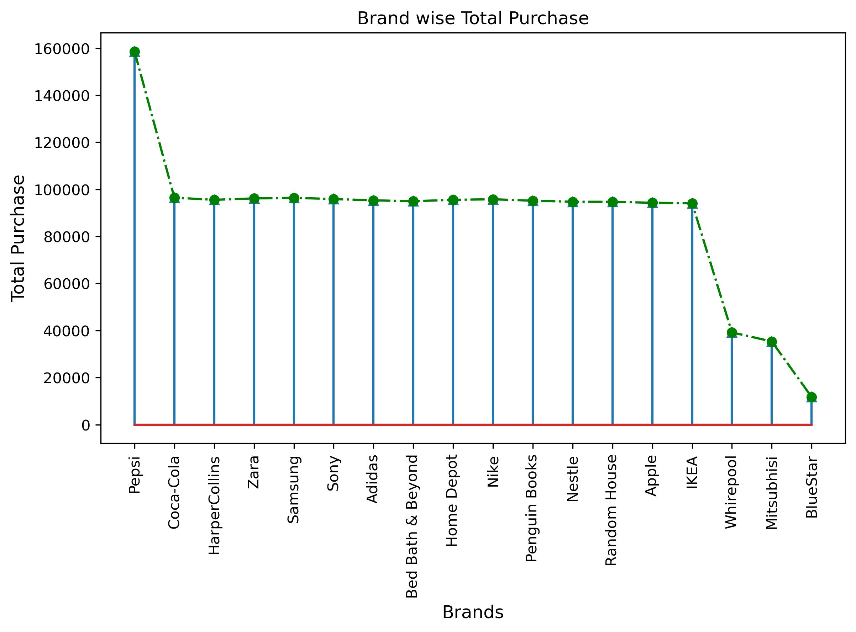

Slide 17
Conclusion: The analysis highlights a clear hierarchy of product performance. While Water and Smartphones are driving revenue and sales, categories like Snacks, ACs, and Tools are underperforming. Strategic decisions such as focusing on top/mid-range products and phasing out low performers can enhance business efficiency and profitability. On the other-hand highest potential Sales growth is Chicago, followed by Portsmouth, San Francisco, and Frankfurt are the second most highest Sales regions. Additionally, brands like Whirlpool, Mitsubishi and BlueStar require targeted promotional or pricing adjustments to improve their market competitiveness due to current underperformance.

